Slide 1


Support Vector Machines

Slide 2




HOW IT WORKS
S U P P O R T V E C T O R M A C H I N E S

Slide 3
HOW IT WORKS
S U P P O R T V E C T O R M A C H I N E S

Slide 4
HOW IT WORKS
S U P P O R T V E C T O R M A C H I N E S

Slide 5
THE MAXIMUM MARGIN PRINCIPLE
S U P P O R T V E C T O R M A C H I N E S
B
A

Slide 6
THE MAXIMUM MARGIN PRINCIPLE
S U P P O R T V E C T O R M A C H I N E S
B
A

Slide 7
SUPPORT VECTORS
S U P P O R T V E C T O R M A C H I N E S
B

Slide 8
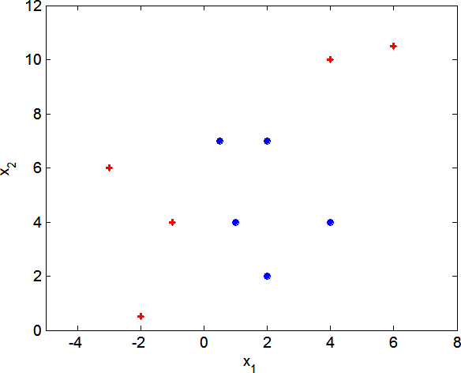
NON LINEAR PATTERNS
S U P P O R T V E C T O R M A C H I N E S

Slide 9
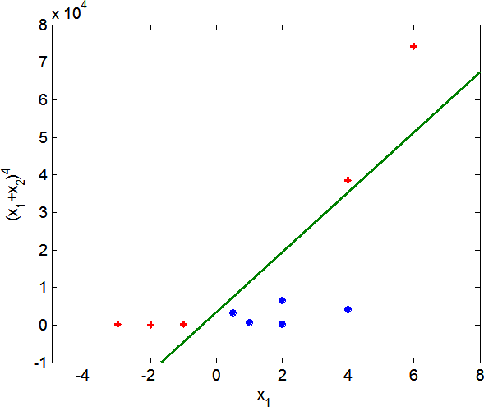
NON LINEAR PATTERNS
S U P P O R T V E C T O R M A C H I N E S

Slide 10
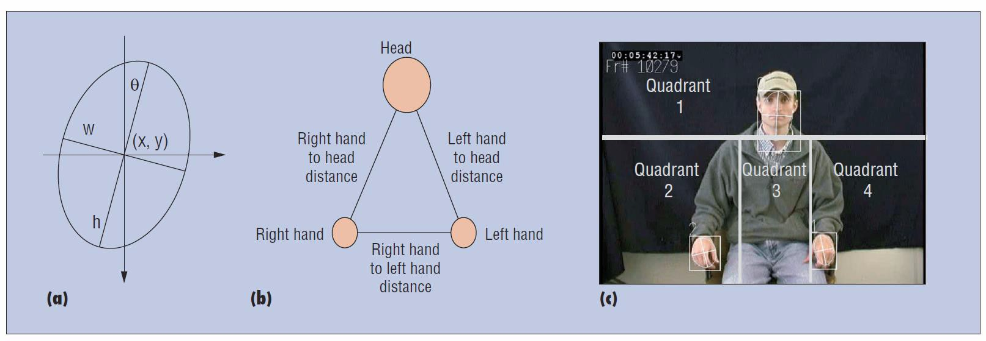
SVM DECEPTION DETECTION EXAMPLE
S U P P O R T V E C T O R M A C H I N E S

